Slide 1


Engineering mechanics Project presentation
Muhammad Junaid Ali 290927
Amur Saqib Pal 288334
Mohammad Shehroz Ashraf 294966
Syed Zoraiz Ali Sherazi 282629
Muhammad Faiez Kazi 295848
Sannan Zia Abbasi 293786

Slide 2
Contents:
Concepts used
Problem statement
Key points of Solution
MATLAB implementation
conclusion

Slide 3

Concepts used:
Conditions of Equilibrium in Three-Dimensional force system
Free body Diagrams
Position Vector and force vectors along a line
Principal of moments and moment about specific axis
Cross product and Resolution of forces
SOFTWARE USED FOR IMPLEMENTATION: “MATLAB”

Slide 4

Problem Statement:
The vertical shaft AB, as shown, is mounted through bearings at A and B and is supporting a uniform rectangular plate ABED with mass m and edges length AB = DE = h and AD = BE = b. The mass of the shaft is negligible and the mass of the plate is m. The distance between the upper bearing located at B and the lower bearing located at A is equal with h. The bearing at A supports the entire vertical load.A moment of magnitude Me is applied to shaft in the vertically upward direction. The plate is constrained from rotating about the vertical axis by the action of a cable attached to outside corner of the plate denoted by D. The other end of the cable is attached to a fixed support point P that is in a perpendicular line PA to the pate. The perpendicular distance from the cable attachment point, P, to the plate is equal to PA = a. Find the bearing reaction forces and the tension in the cable PD.
h = 0.8m; b = 0.6m; a = 0.4m ;m = 80 kg; Me = 100Nm; g = 9.81 m/s2

Slide 5

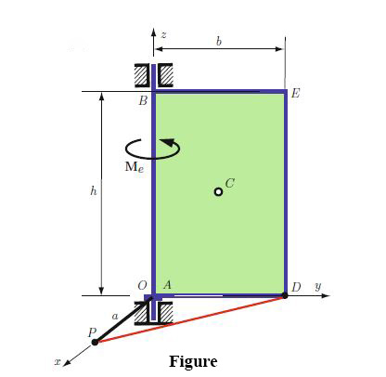
Key points of solution:
Bearings At point A and B exert force in the perpendicular direction to the force along shaft.
The force of plate attached to shaft is vertically downward and Calculated as F=mg
Start by making our reference axis With origin at A. the bearing force of interest at A and B acts on the mechanical system.
The mechanical system is also acted upon by the cable force on the plate, and the three bearing reactions at A.
We then proceed to write the equations and solve em on matlab

Slide 6

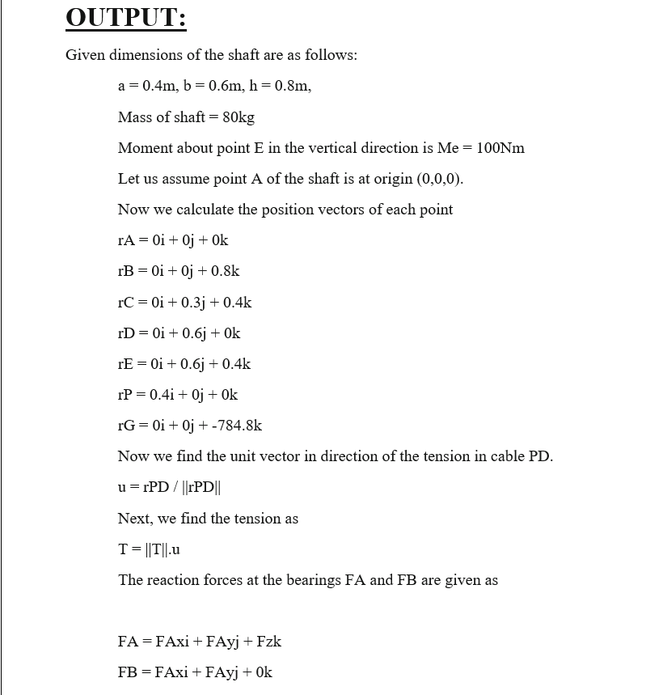
Matlab implementation:
Functions used:
fprintf
Syms
Cross
solve
axis
quiver3
scatter3
prism
xlabel etc.

Slide 7
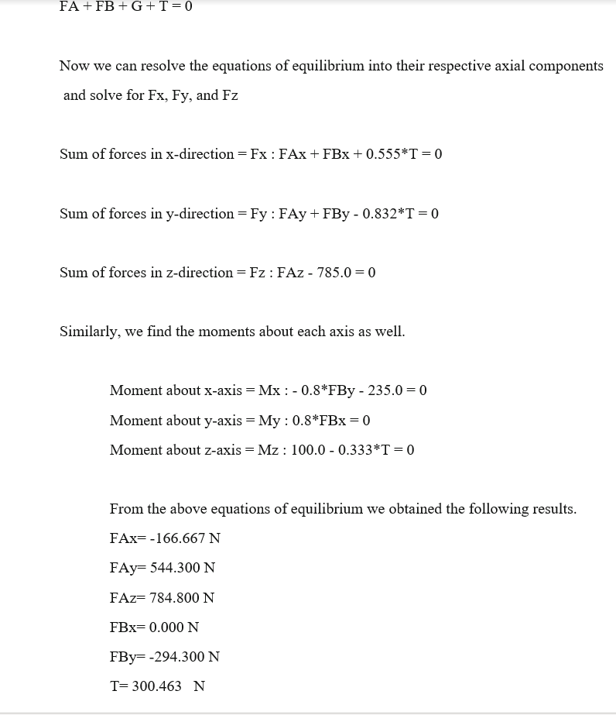
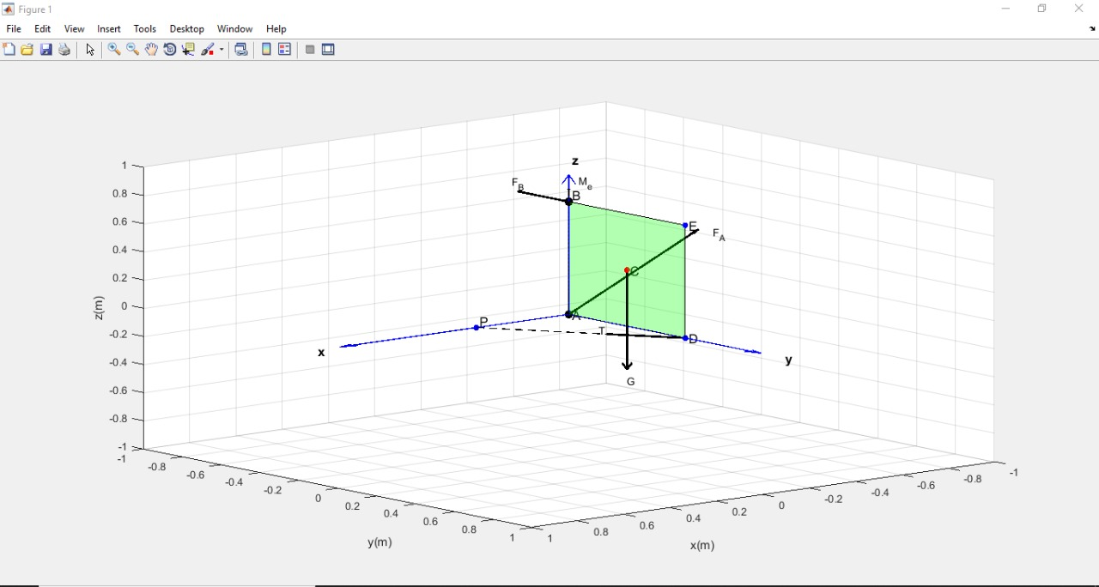
Matlab implementation: (output)

Slide 8
Conclusion:
Used and implemented Moment in 3D systems,
Applied equilibrium equations and calculated moments about a point or axis
Created and simulated a mathematical model on MATLAB
Verified the results with our theoretical solution.

Slide 9
THANK YOU

